Slide 1
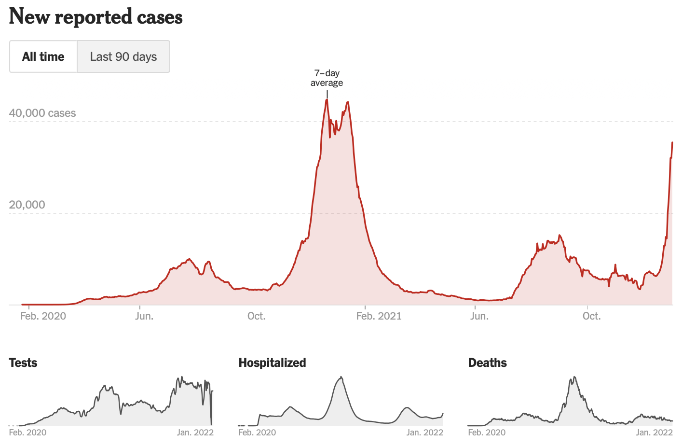
Pandemic Update Rotary District 5160
Omicron update
Majority of cases in California (estimated 50% - 70%)
Hard to get variant data by county
Appears to be much more infectious (R⁰ =10, Delta was 7, original COVID 2-3)
Appears to be less deadly or likely to lead to hospitalization
California
Data
NYTimes Vaccine Tracker

Slide 2
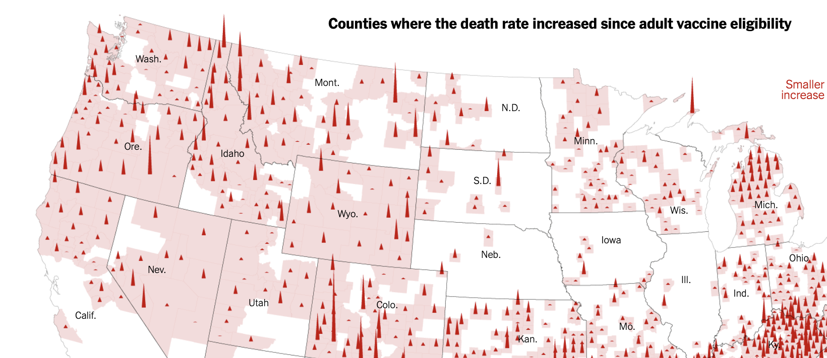
COVID Death Rates Rising in Some
NYTimes 12/28/21

Slide 3
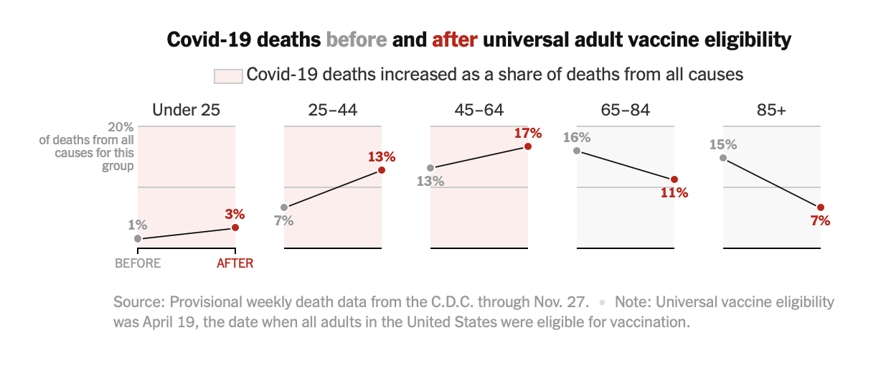
COVID Deaths – Age Counts (again)
NYTimes 12/28/21

Slide 4
New 5160 COVID Cases (1/1/22)
NYTimes COVID Tracker

Slide 5
Case Rate & Vaccination Rate
Source – NYTimes COVID Tracker

Slide 6
Vaccination Rate & Hospitalizations
+3
+14
+12
-2
(#) of Rotary Clubs in county
Hospitalizations - % change in last 14 days
NYTimes COVID Tracker

Slide 7
Vaccination Rate & Hospitalizations
-11
+3
-41
Hospitalizations - % change in last 14 days
NYTimes COVID Tracker

Slide 8
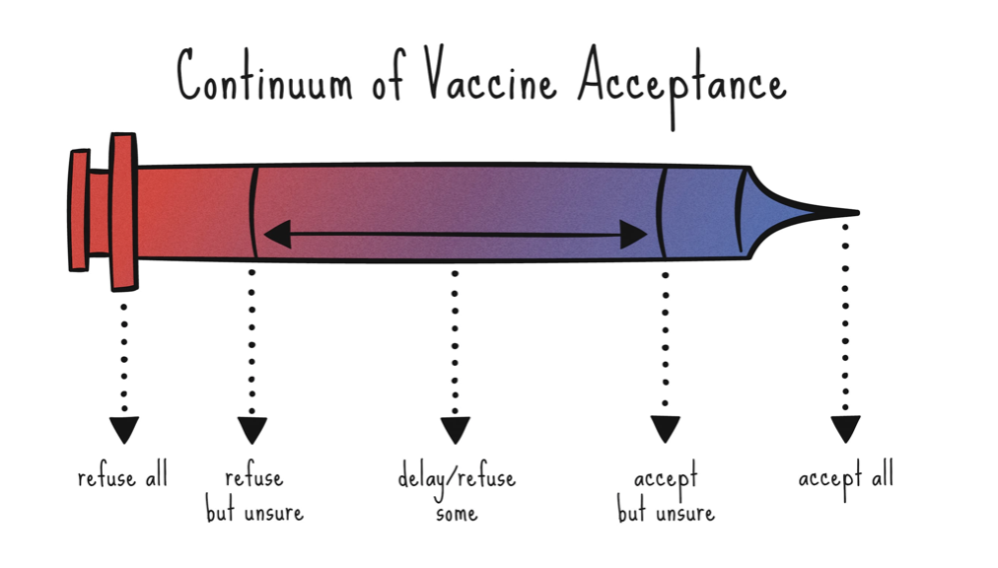
Vaccine Hesitancy
New term – describes a range of reasons why someone hasn’t gotten vaccinated

Slide 9
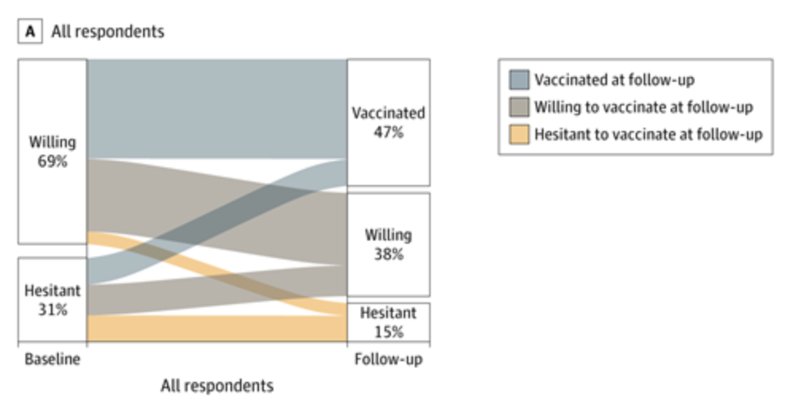
Natural History of Hesitancy

Slide 10
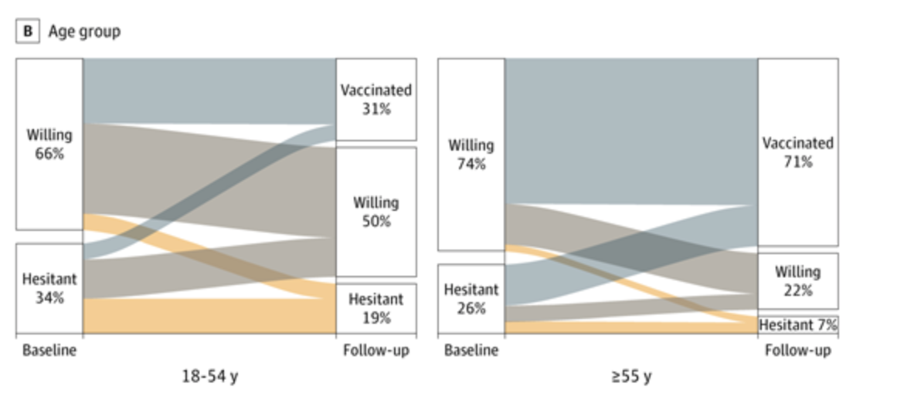
Hesitancy and Age

Slide 11
Hesitancy and Ethnicity
Siegler AJ, JAMA Network Open, 9/24/21

Slide 12
Useful and Interesting Websites
For dealing with someone who is hesitant
Hopkins Vaccine Hesitancy info
The Vaccine Confidence Project
https://www.vaccineconfidence.org
Possible use of chatbots
https://www.gavi.org/vaccineswork/are-chatbots-better-humans-fighting-vaccine-hesitancy

Slide 13
Dealing With Family & Friends
Identify where they are on the spectrum of hesitancy
Likely not going to change people’s minds if they are set in their opinion
Goal – find what they are unsure about
Ask more questions than give answers
Don’t get into a data fight, unless you know that’s what persuades them

Slide 14
Talking About Vaccine Hesitancy
Ask for permission
If they say no, respect it but offer an open door
Ask lots of questions
Aim for the middle ground
Try to understand doubts
Share your experience
Relate it to things they already do
Driving safely vs. seatbelts
Cleveland Clinic Guide

Slide 15
Motivational Interviewing
Asking
Open-ended questions
“I see, tell me more about that.”
Don’t end it early
Listening
Attentive gaze with good eye contact
Not distracted (not looking at your phone)
Informing
Ask permission to give information
Chunk – check - chunk
Notes:
Avoid “I understand”

Slide 16
The Real Goal
Although we’d love our loved one to get the vaccine, we have to let go of that concern, for now
The goal is to discover ambivalence
If the listener feels ambivalence, they are more likely to change
You also want them to know your stance, but after you’ve heard theirs

Slide 17
Bob Wachter’s Immunity Levels
3 mRNAs + infection (super immune)
3 mRNAs (very immune)
2 mRNAs or J&J + mRNA (modestly immune)
1 mRNA or J&J alone, or infection alone (minimally immune)
No shots AND no infection (totally vulnerable)
Bob Wachter, MD UCSF Twitter 17 Dec 21

Slide 18
Questions?
Continue in-person meetings?
Continue hybrid meetings?
Use only Zoom meetings?
Require or advise attendees to be vaccinated?
Require or advise attendees to self-test 30 minutes before the meeting?
Develop strategies to provide service to the larger community? (District Grants?)

Slide 19
Resources
Omicron and vaccines (Lancet)
CDC – Omicron Variant
CDC – Testing
Consumer Reports Health
How to use home tests (NYT)
What to do if you test positive? (NYT)
How to double mask (NYT)

